Slide 1


The purpose of this front-end webpage is to develop a travel agency site and latest information about hotels/flights /car hire this also include offering different products such as flights and many other features .

Slide 2



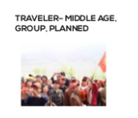

Target Audience

